Slide 1
Classifier: Decision Tree

Slide 2
Classification: Definition
Given a collection of records (training set )
Each record is by characterized by a tuple (x,y), where x is the attribute set and y is the class label
x: attribute, predictor, independent variable, input
y: class, response, dependent variable, output
Task:
Learn a model that maps each attribute set x into one of the predefined class labels y

Slide 3
Examples of Classification Task
Task | Attribute set, x | Class label, y
Categorizing email messages | Features extracted from email message header and content | spam or non-spam
Identifying tumor cells | Features extracted from x-rays or MRI scans | malignant or benign cells
Cataloging galaxies | Features extracted from telescope images | Elliptical, spiral, or irregular-shaped galaxies

Slide 4
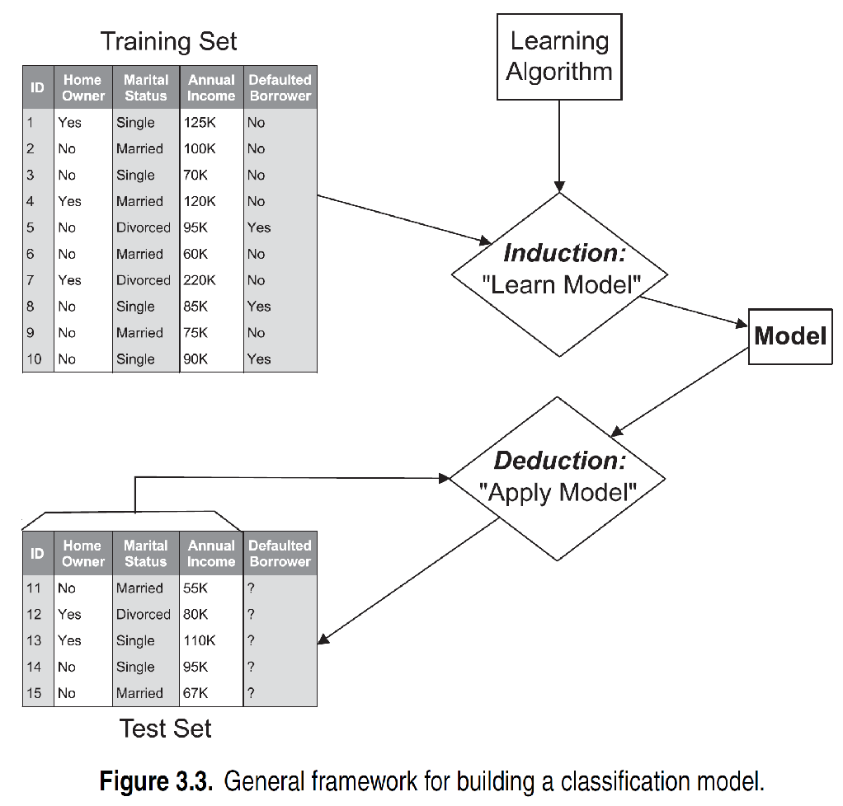
General Approach for Building Classification Model

Slide 5
Classification Techniques
Base Classifiers
Decision Tree based Methods
Rule-based Methods
Nearest-neighbor
Naïve Bayes and Bayesian Belief Networks
Support Vector Machines
Neural Networks, Deep Neural Nets
Ensemble Classifiers
Boosting, Bagging, Random Forests

Slide 6
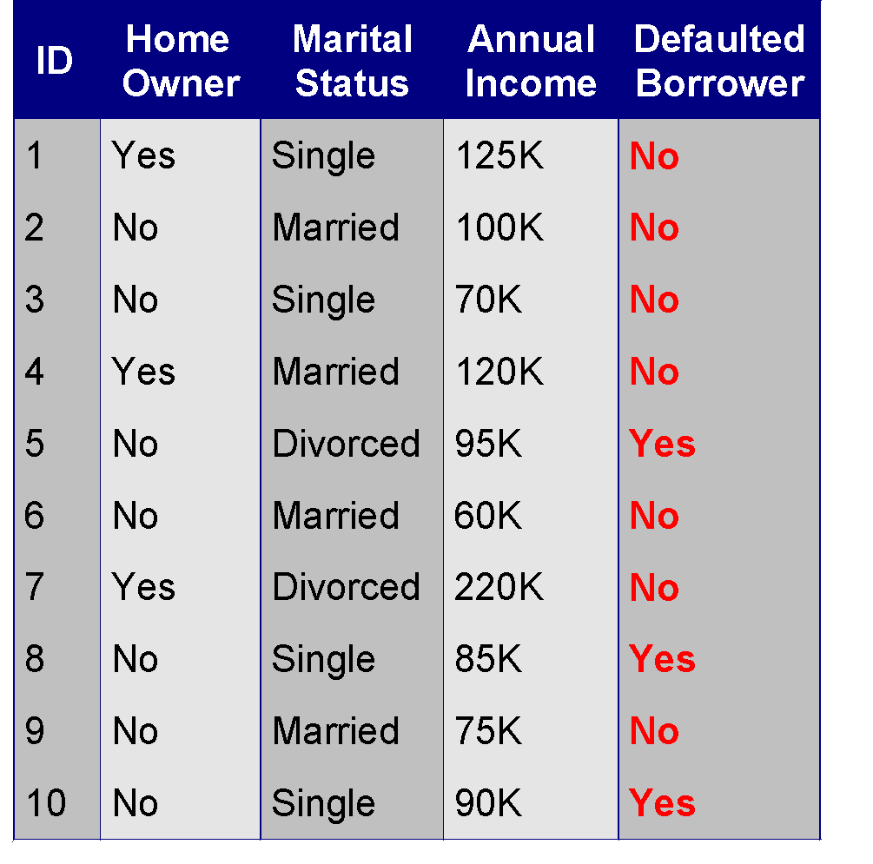
Example of a Decision Tree
categorical
categorical
continuous
class
Splitting Attributes
Home Owner
Yes
No
NO
MarSt
Single, Divorced
Married
Income
NO
< 80K
> 80K
NO
YES
Training Data
Model: Decision Tree

Slide 7
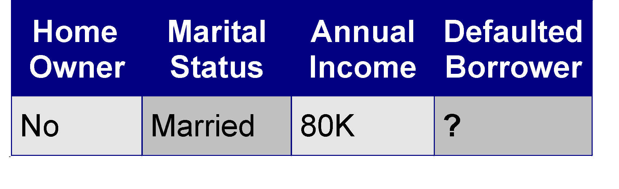
Apply Model to Test Data
Test Data
Start from the root of tree.
Home Owner
Yes
No
NO
MarSt
Single, Divorced
Married
Income
NO
< 80K
> 80K
NO
YES

Slide 8
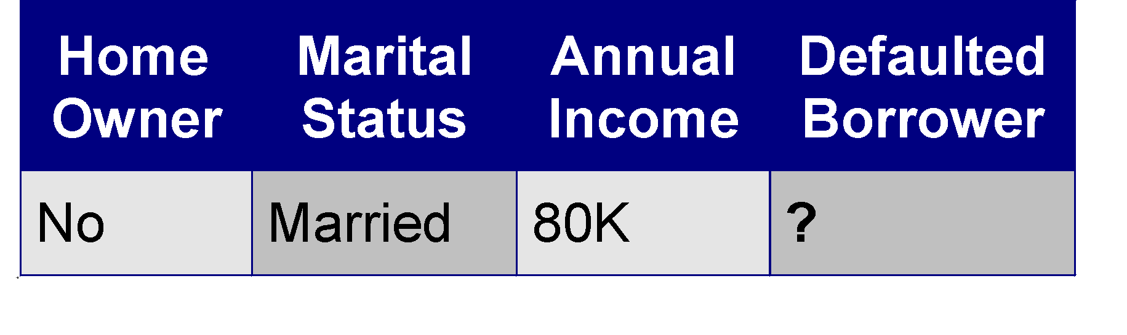
Apply Model to Test Data
Test Data
Home Owner
Yes
No
NO
MarSt
Single, Divorced
Married
Income
NO
< 80K
> 80K
NO
YES

Slide 9
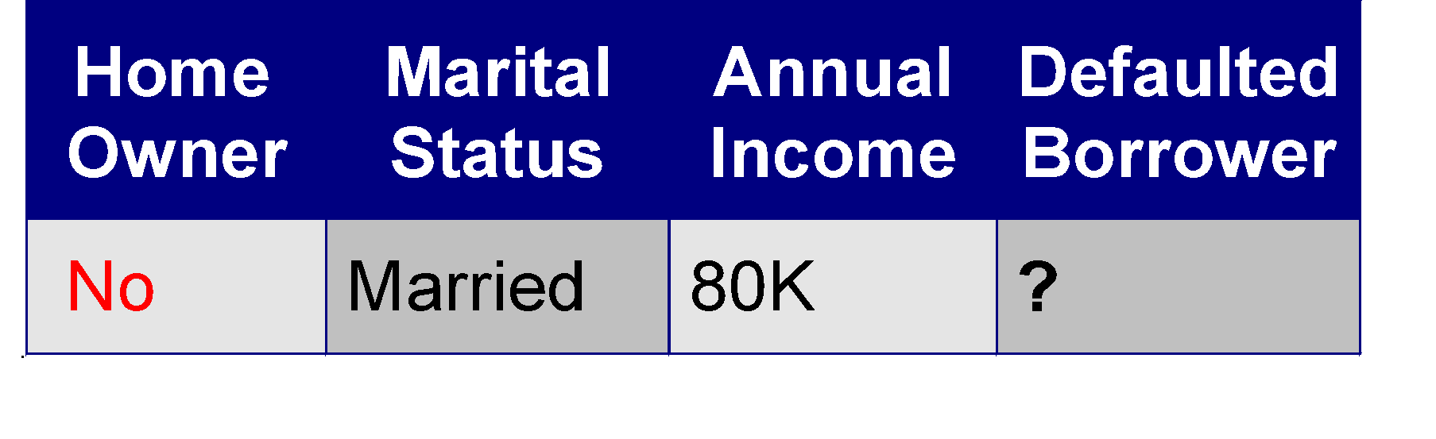
Apply Model to Test Data
Test Data
Home Owner
Yes
No
NO
MarSt
Single, Divorced
Married
Income
NO
< 80K
> 80K
NO
YES

Slide 10
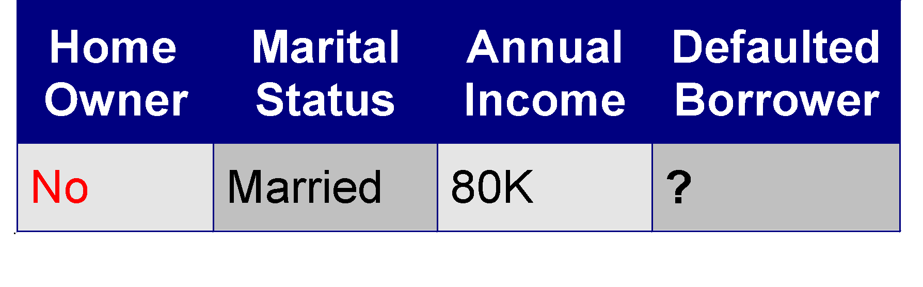
Apply Model to Test Data
Test Data
Home Owner
Yes
No
NO
MarSt
Single, Divorced
Married
Income
NO
< 80K
> 80K
NO
YES

Slide 11
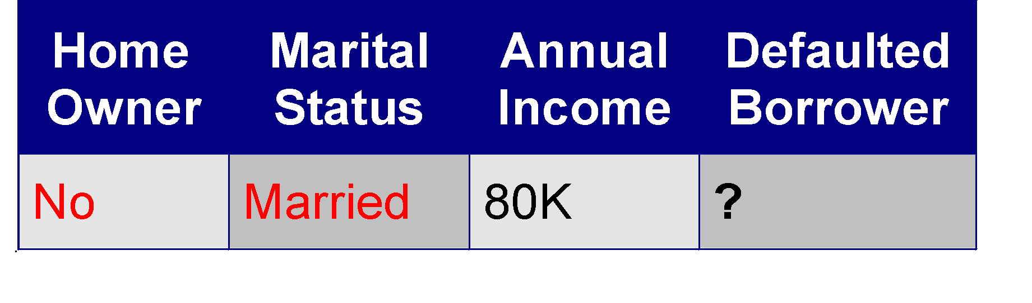
Apply Model to Test Data
Test Data
Home Owner
Yes
No
NO
MarSt
Single, Divorced
Married
Income
NO
< 80K
> 80K
NO
YES

Slide 12
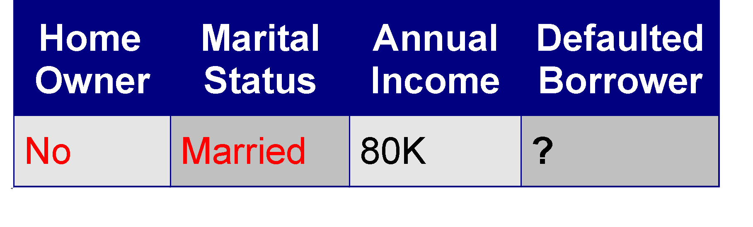
Apply Model to Test Data
Test Data
Home Owner
Yes
No
NO
MarSt
Single, Divorced
Married
Assign Defaulted to “No”
Income
NO
< 80K
> 80K
NO
YES

Slide 13

Another Example of Decision Tree
categorical
categorical
continuous
class
Single, Divorced
MarSt
Married
NO
Home Owner
Yes
No
NO
Income
< 80K
> 80K
NO
YES
There could be more than one tree that fits the same data!

Slide 14
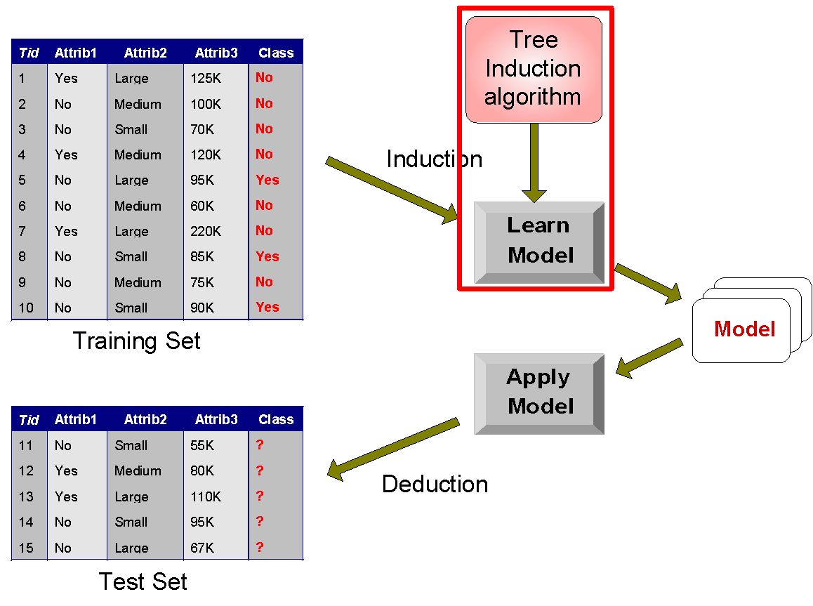
Decision Tree Classification Task
Decision Tree

Slide 15
Decision Tree Induction
Many Algorithms:
Hunt’s Algorithm (one of the earliest)
CART
ID3, C4.5
SLIQ,SPRINT

Slide 16
General Structure of Hunt’s Algorithm
Let D_{t} be the set of training records that reach a node t
General Procedure:
If D_{t} contains records that belong the same class y_{t}, then t is a leaf node labeled as y_{t}
If D_{t} contains records that belong to more than one class, use an attribute test to split the data into smaller subsets. Recursively apply the procedure to each subset.
D_{t}
?

Slide 17
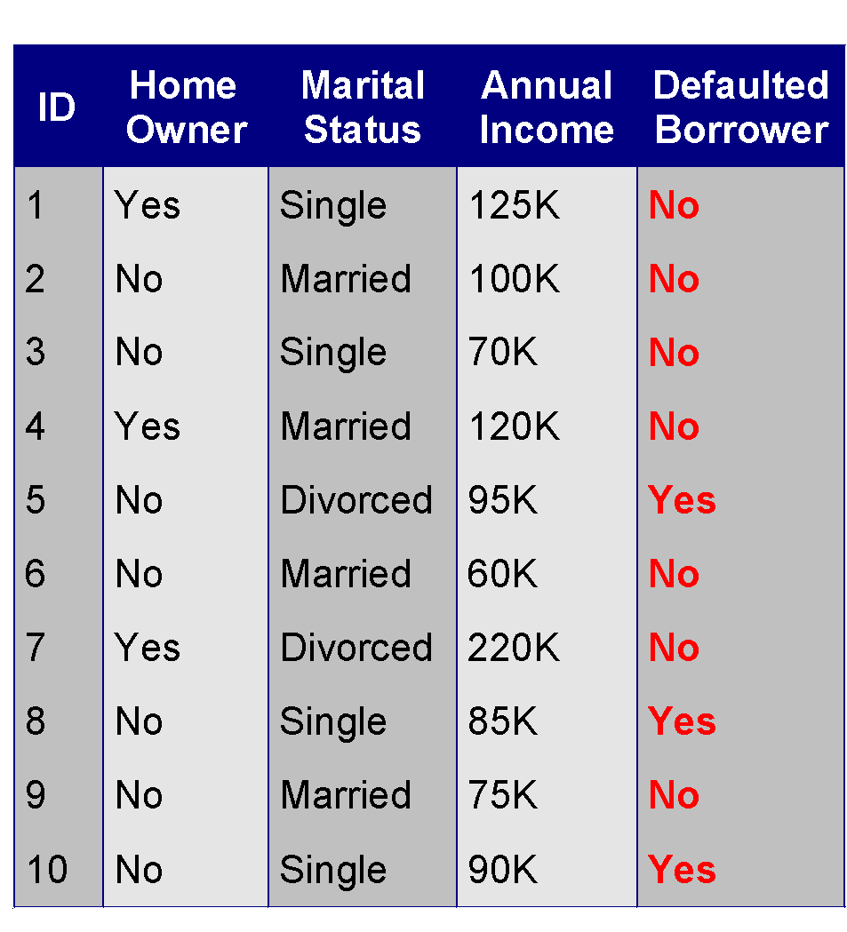
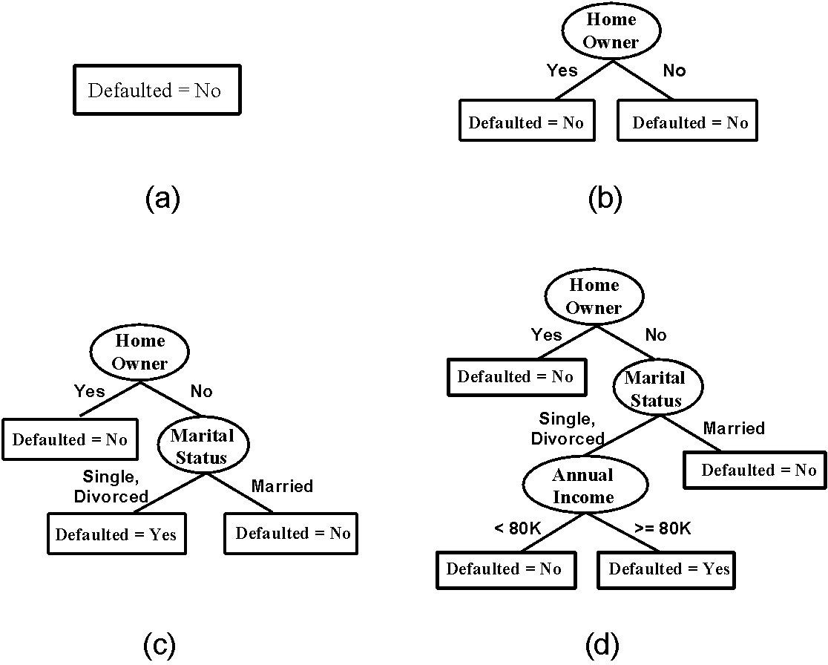
Hunt’s Algorithm
(7,3)
(3,0)
(4,3)
(3,0)
(3,0)
(3,0)
(1,3)
(3,0)
(1,0)
(0,3)

Slide 18
Hunt’s Algorithm
(7,3)
(3,0)
(4,3)
(3,0)
(3,0)
(3,0)
(1,3)
(3,0)
(1,0)
(0,3)

Slide 19
Hunt’s Algorithm
(7,3)
(3,0)
(4,3)
(3,0)
(3,0)
(3,0)
(1,3)
(3,0)
(1,0)
(0,3)

Slide 20
Hunt’s Algorithm
(7,3)
(3,0)
(4,3)
(3,0)
(3,0)
(3,0)
(1,3)
(3,0)
(1,0)
(0,3)

Slide 21
Design Issues of Decision Tree Induction
How should training records be split?
Method for expressing test condition
depending on attribute types
Measure for evaluating the goodness of a test condition
How should the splitting procedure stop?
Stop splitting if all the records belong to the same class or have identical attribute values
Early termination

Slide 22
Methods for Expressing Test Conditions
Depends on attribute types
Binary
Nominal
Ordinal
Continuous

Slide 23
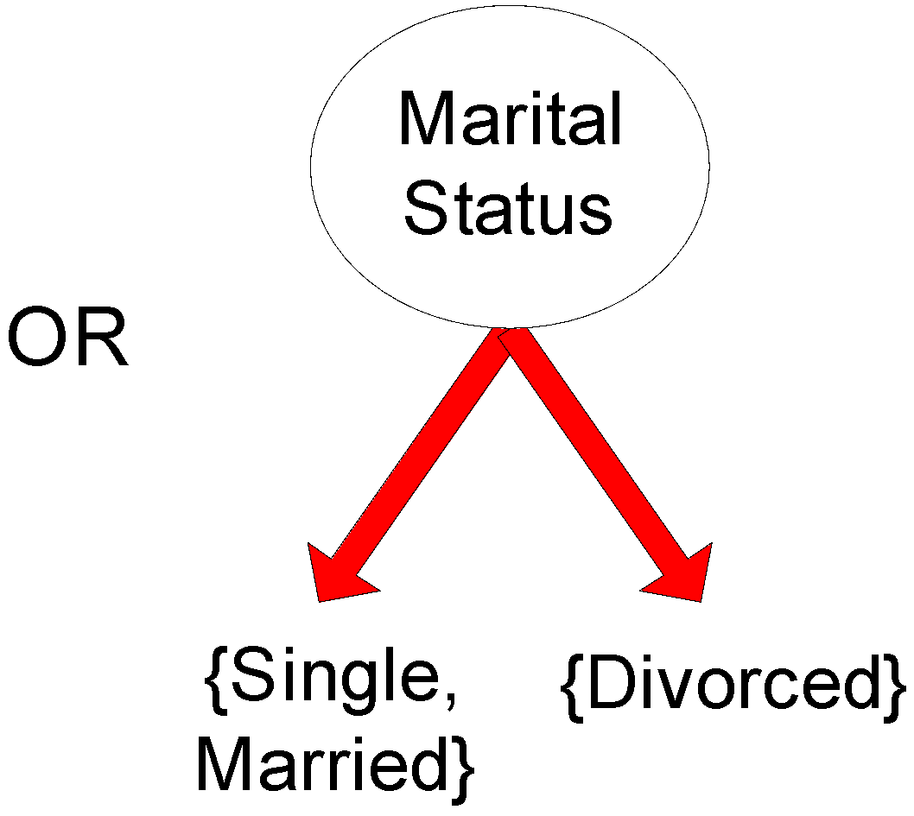
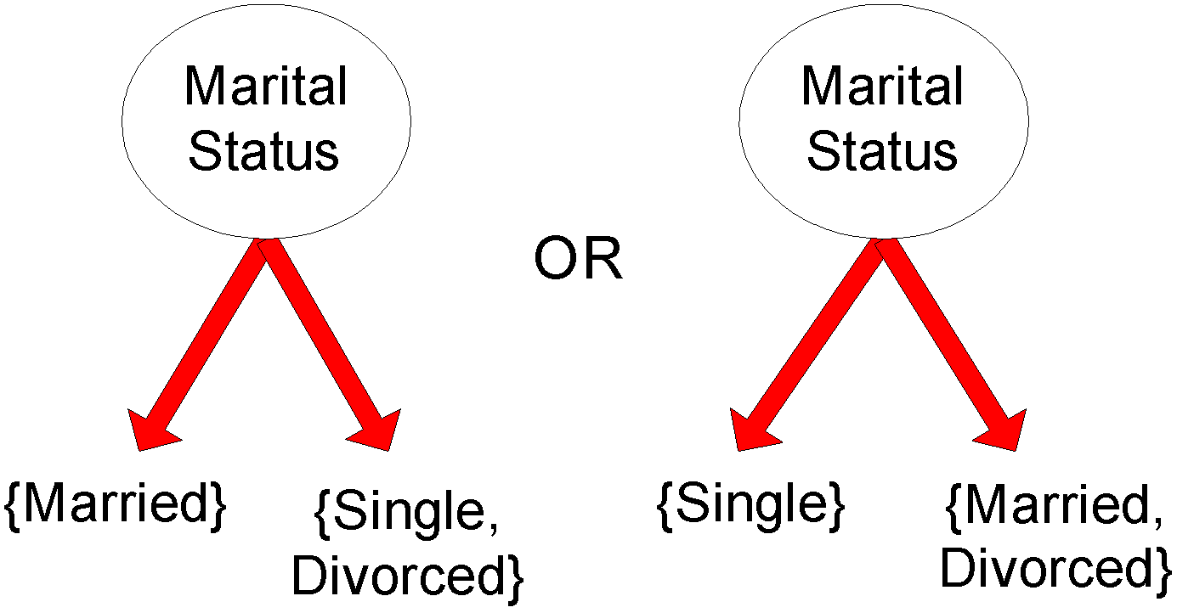
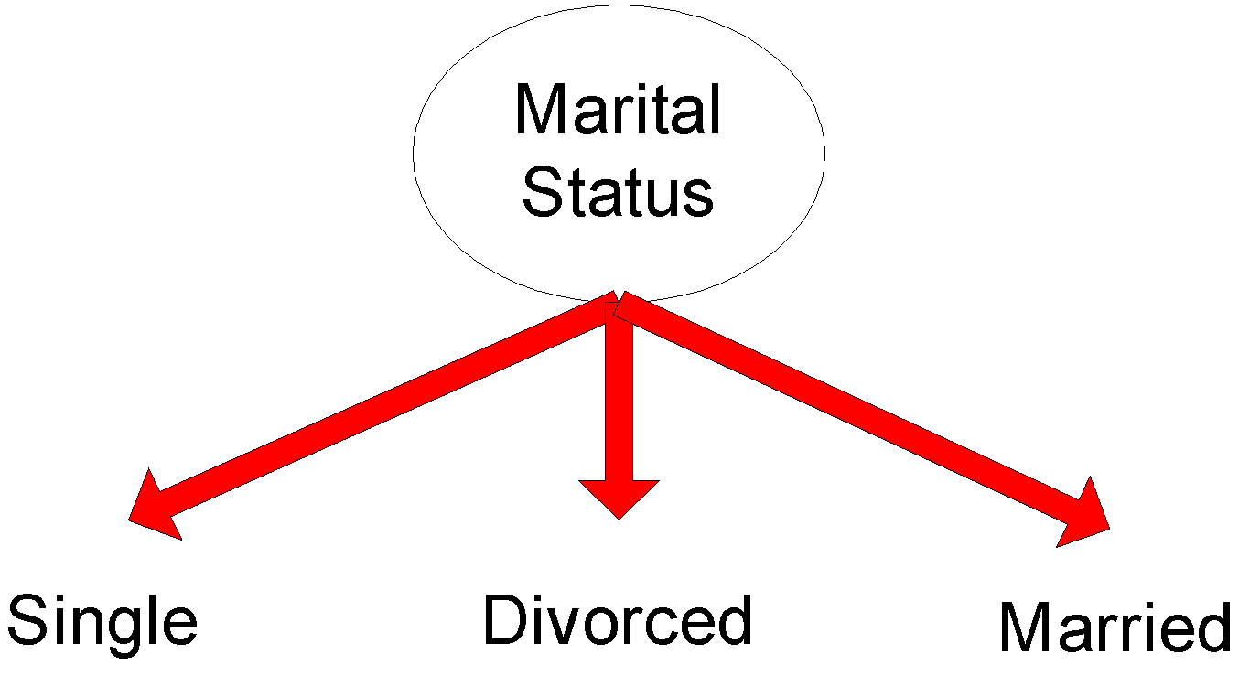
Test Condition for Nominal Attributes
Multi-way split:
Use as many partitions as distinct values.
Binary split:
Divides values into two subsets

Slide 24
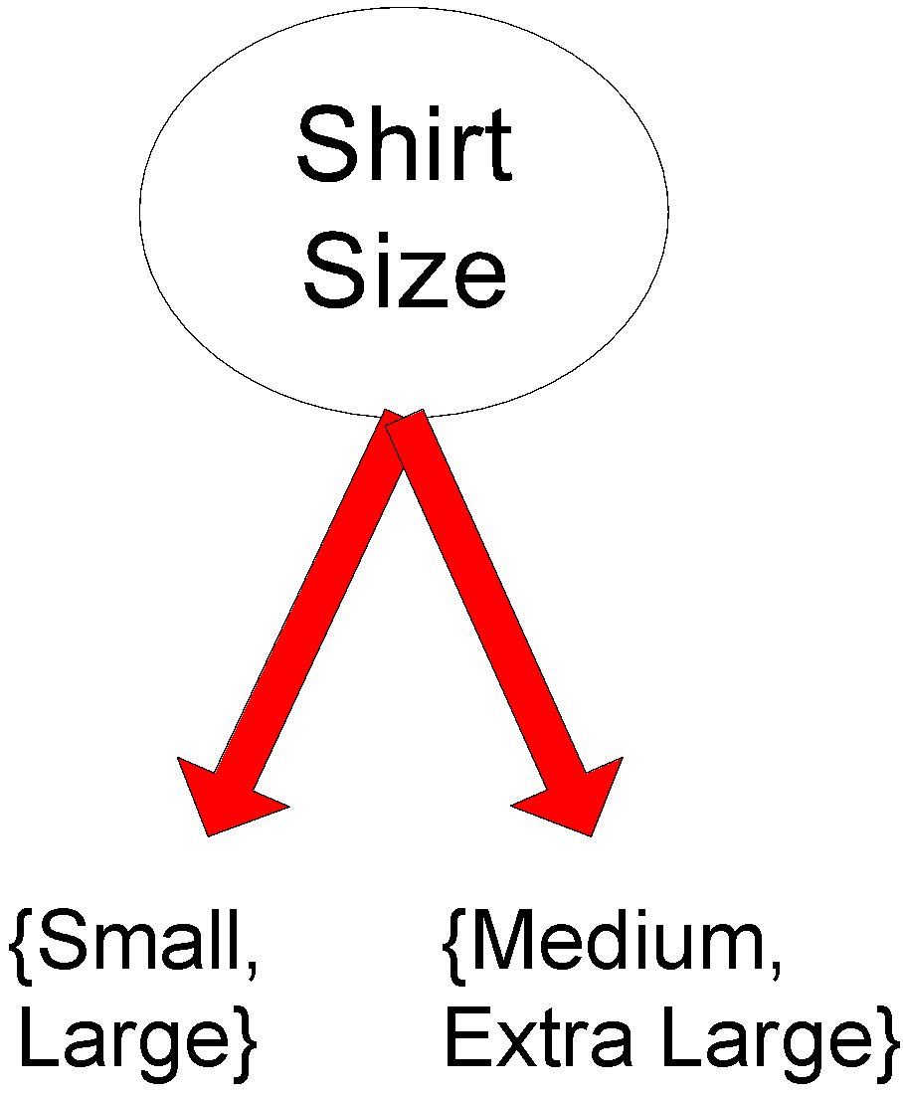
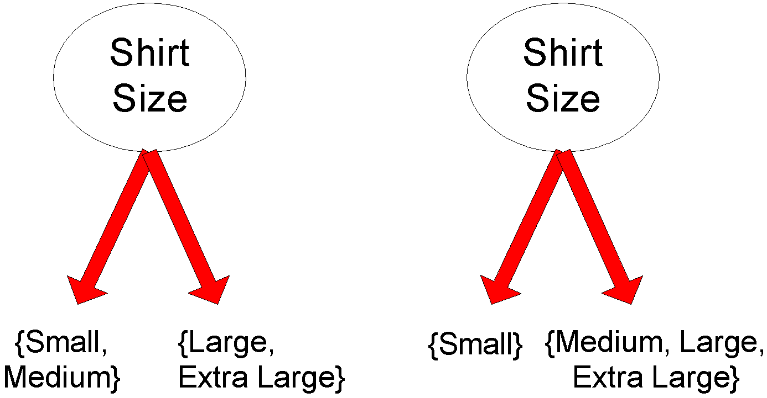
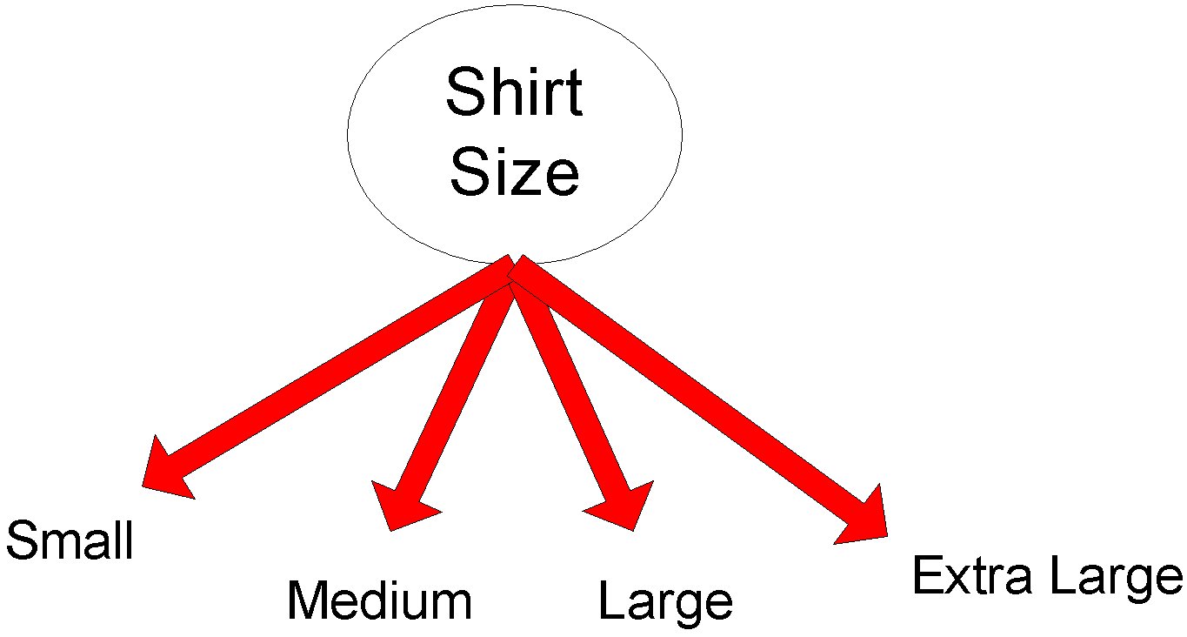
Test Condition for Ordinal Attributes
Multi-way split:
Use as many partitions as distinct values
Binary split:
Divides values into two subsets
Preserve order property among attribute values
This grouping violates order property

Slide 25
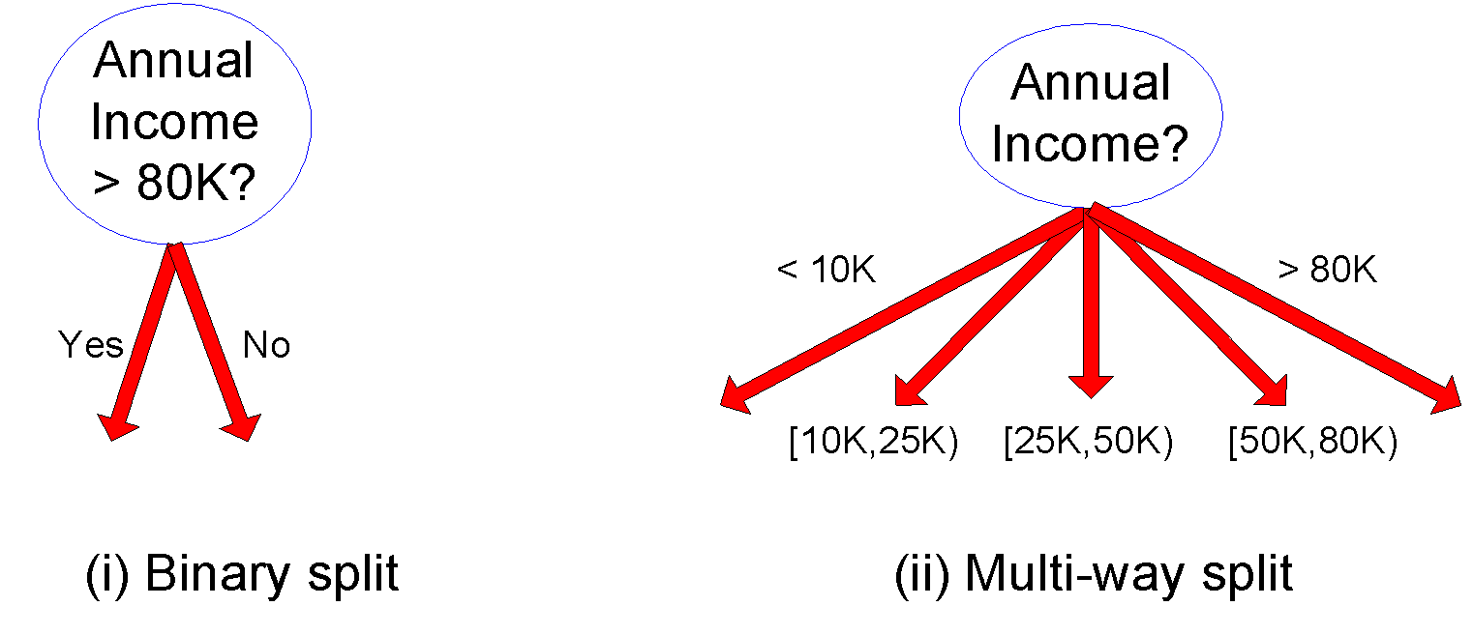
Test Condition for Continuous Attributes

Slide 26
Splitting Based on Continuous Attributes
Different ways of handling
Discretization to form an ordinal categorical attribute
Ranges can be found by equal interval bucketing, equal frequency bucketing (percentiles), or clustering.
Static – discretize once at the beginning
Dynamic – repeat at each node
Binary Decision: (A < v) or (A ≥ v)
consider all possible splits and finds the best cut
can be more compute intensive

Slide 27
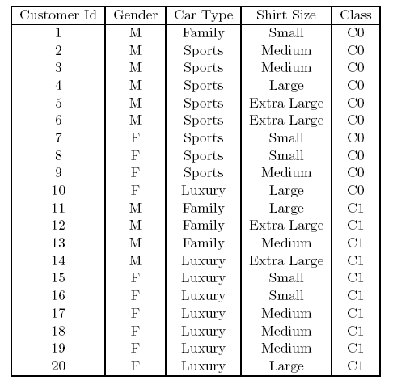
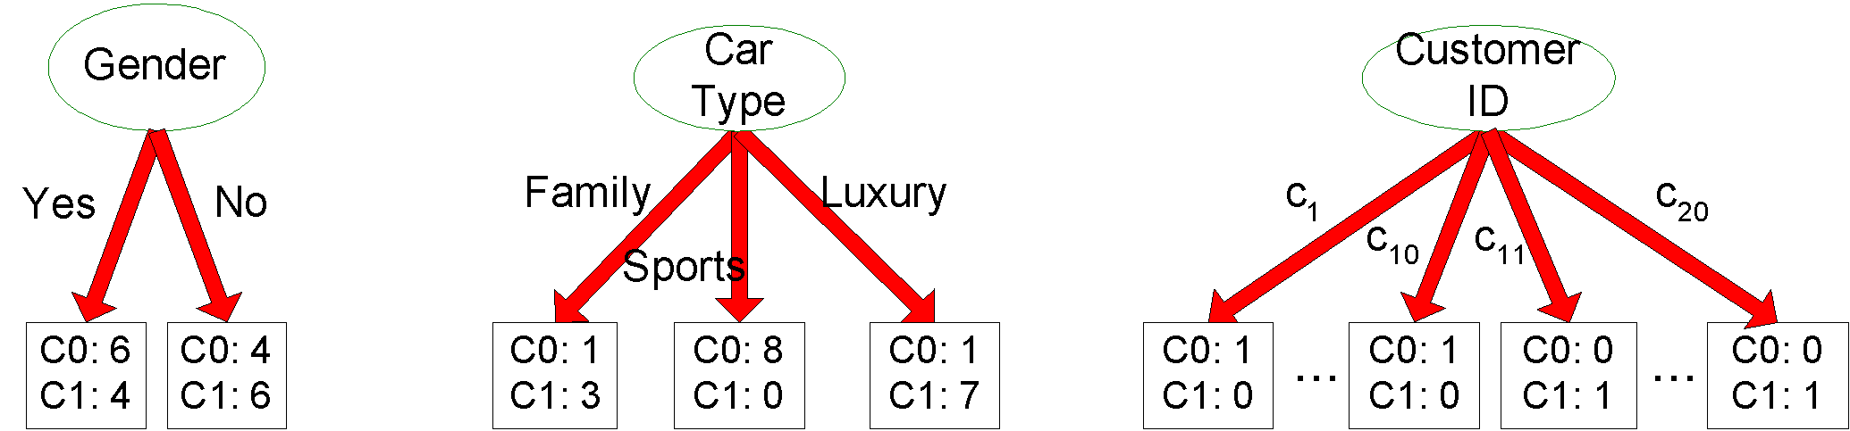
How to determine the Best Split
Before Splitting: 10 records of class 0, 10 records of class 1
Which test condition is the best?

Slide 28
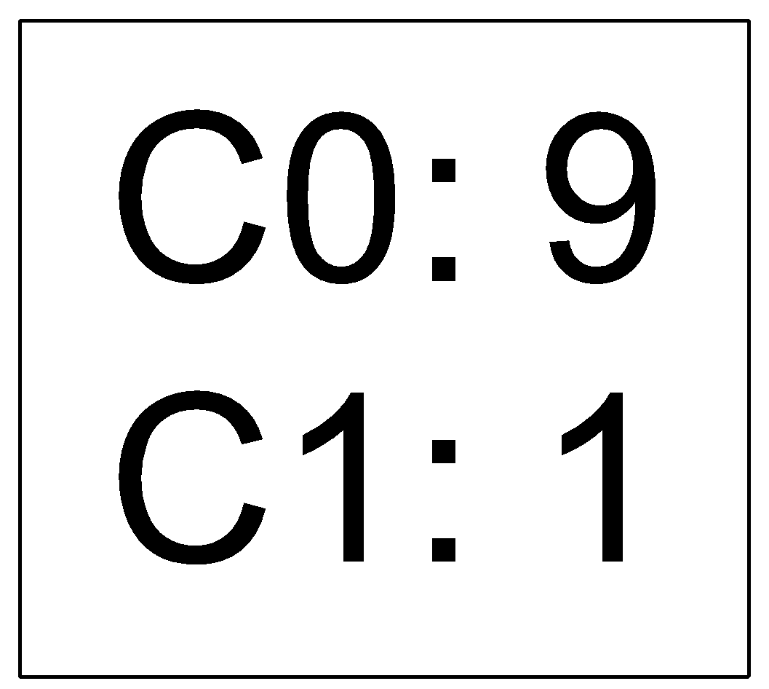
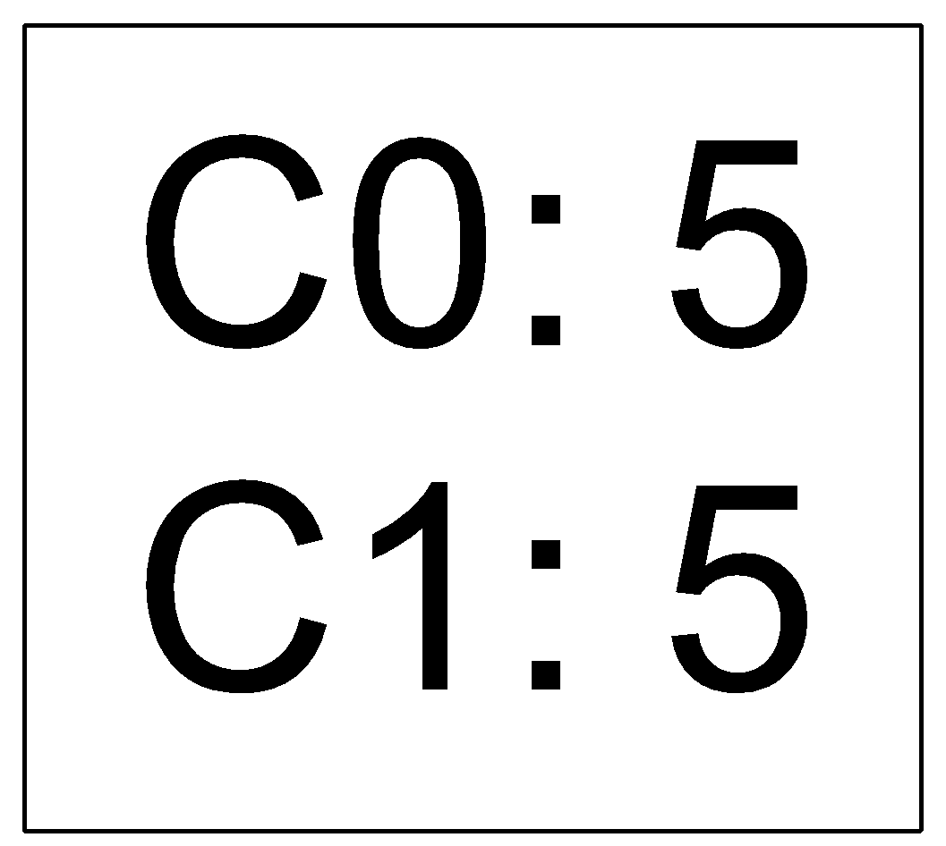
How to determine the Best Split
Greedy approach:
Nodes with purer class distribution are preferred
Need a measure of node impurity:
High degree of impurity
Low degree of impurity

Slide 29
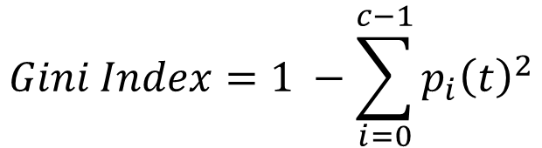
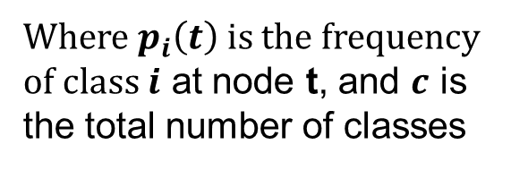
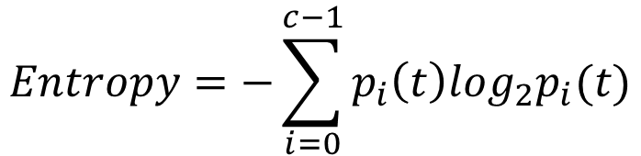
Measures of Node Impurity
Gini Index
Entropy
Misclassification error

Slide 30
Finding the Best Split
Compute impurity measure (P) before splitting
Compute impurity measure (M) after splitting
Compute impurity measure of each child node
M is the weighted impurity of child nodes
Choose the attribute test condition that produces the highest gain
Gain = P - M or equivalently, lowest impurity measure after splitting (M)

Slide 31
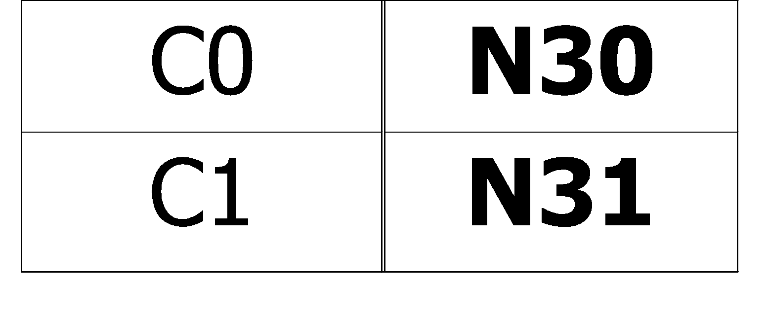
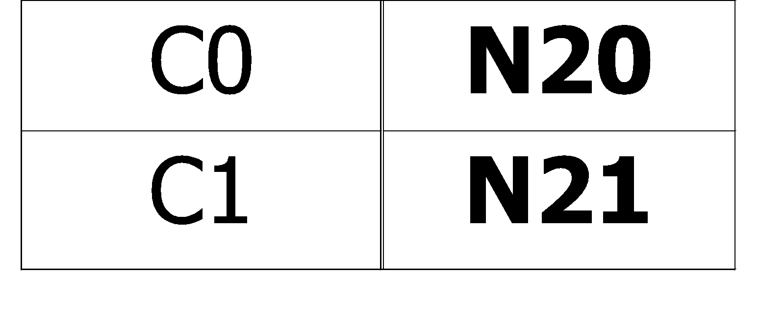
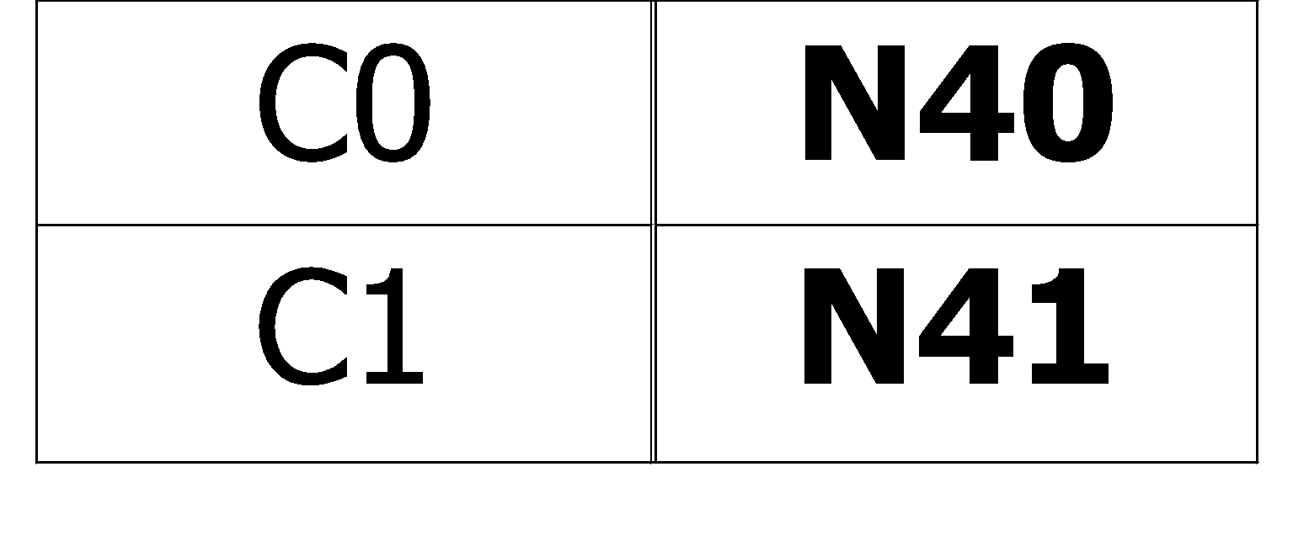
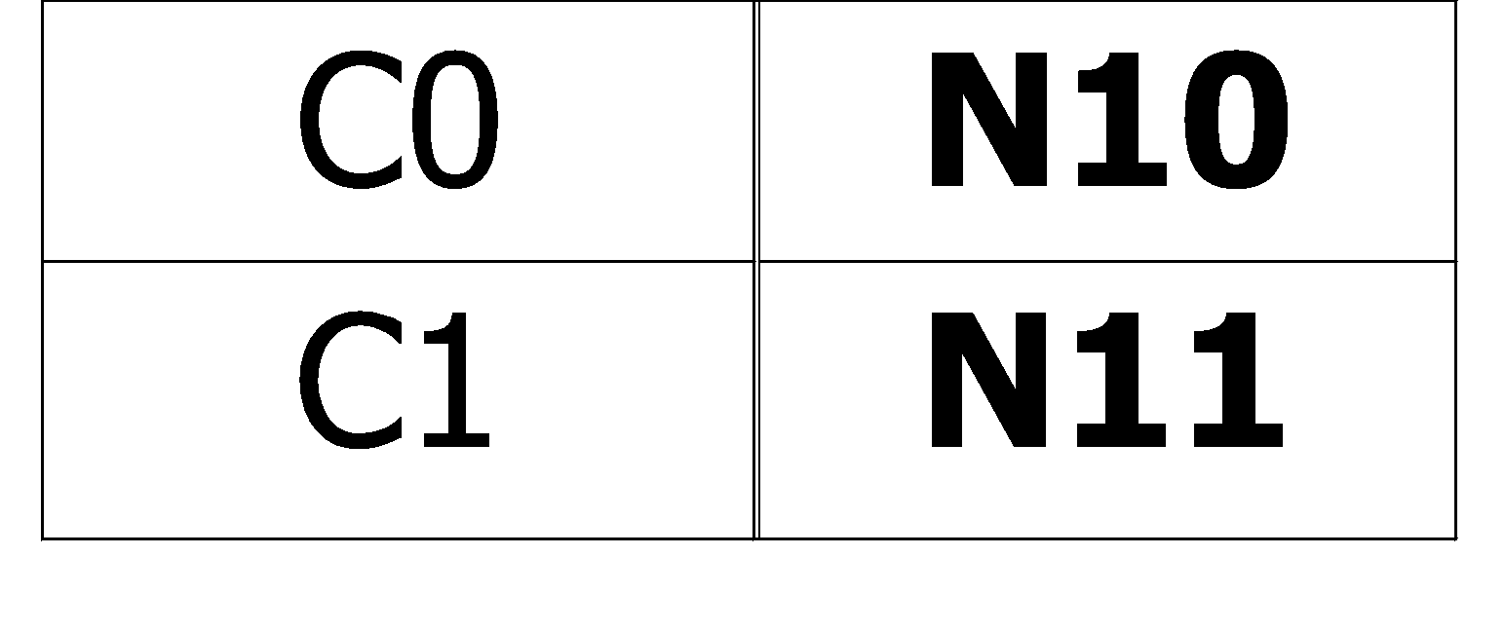
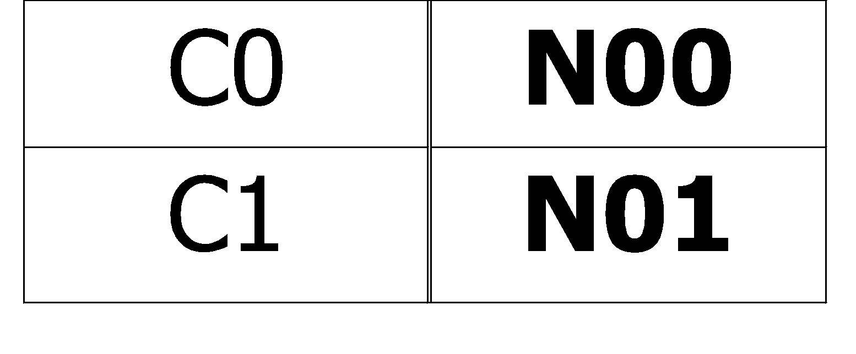
Finding the Best Split
Before Splitting:
P
A?
B?
Yes
No
Yes
No
Node N1
Node N2
Node N3
Node N4
M11
M12
M21
M22
M1
M2
Gain = P – M1 vs P – M2

Slide 32
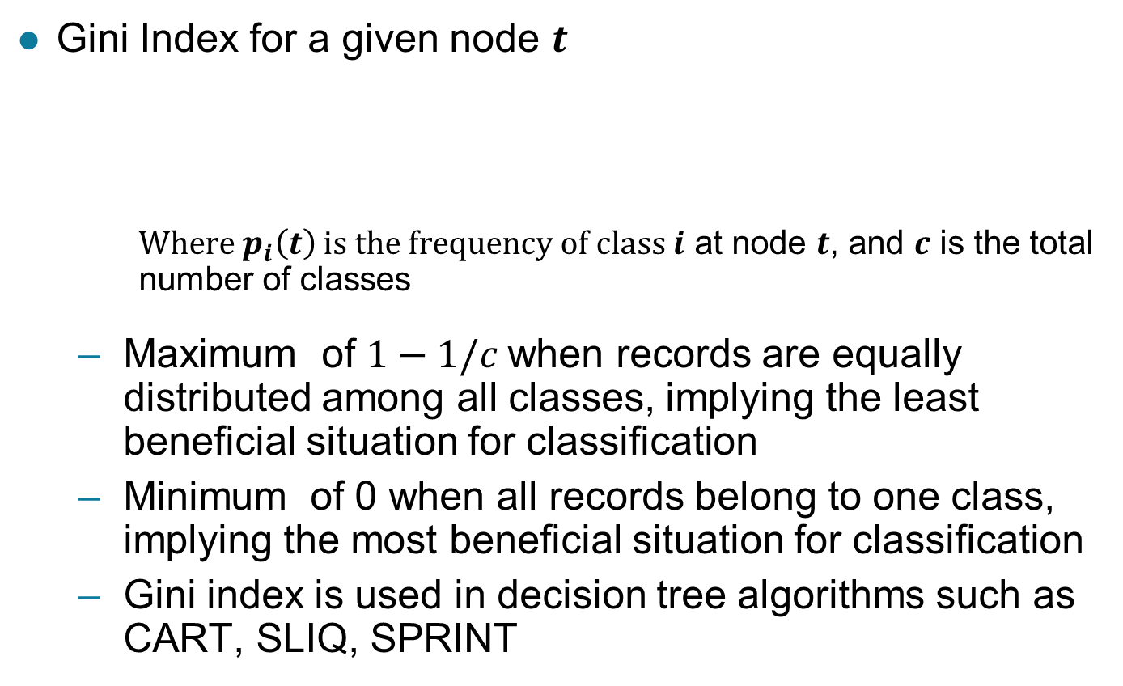
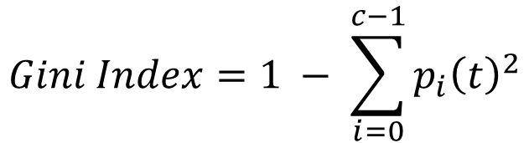
Measure of Impurity: GINI

Slide 33
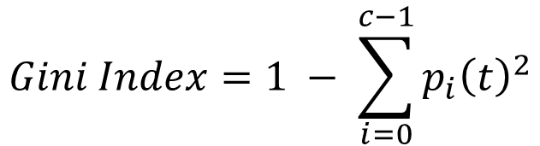
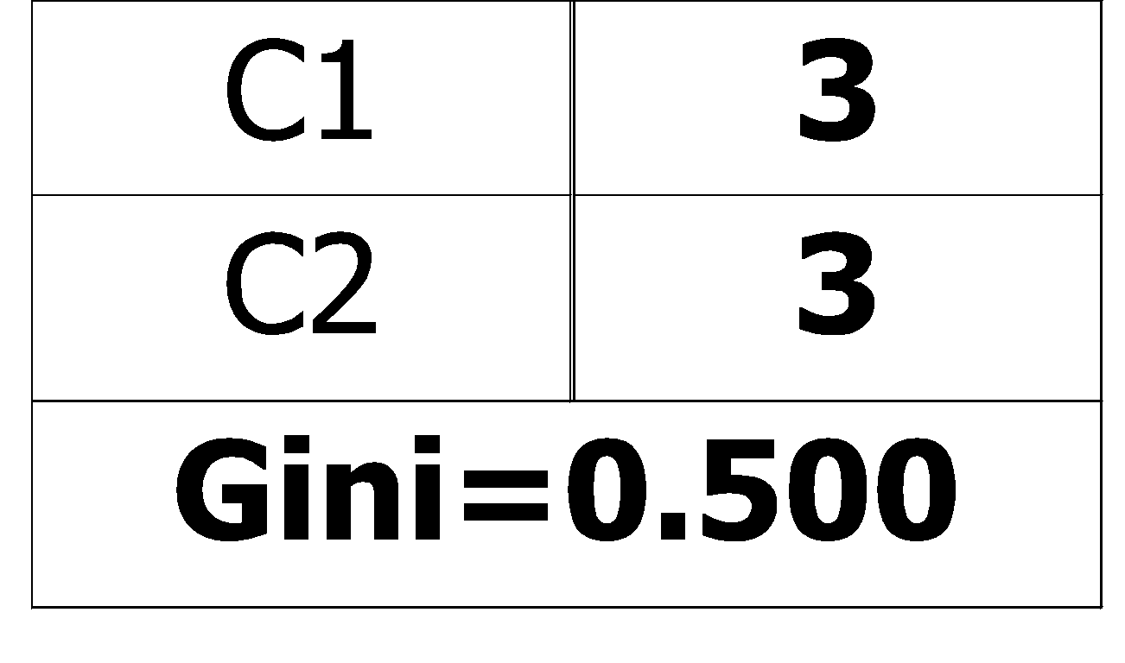
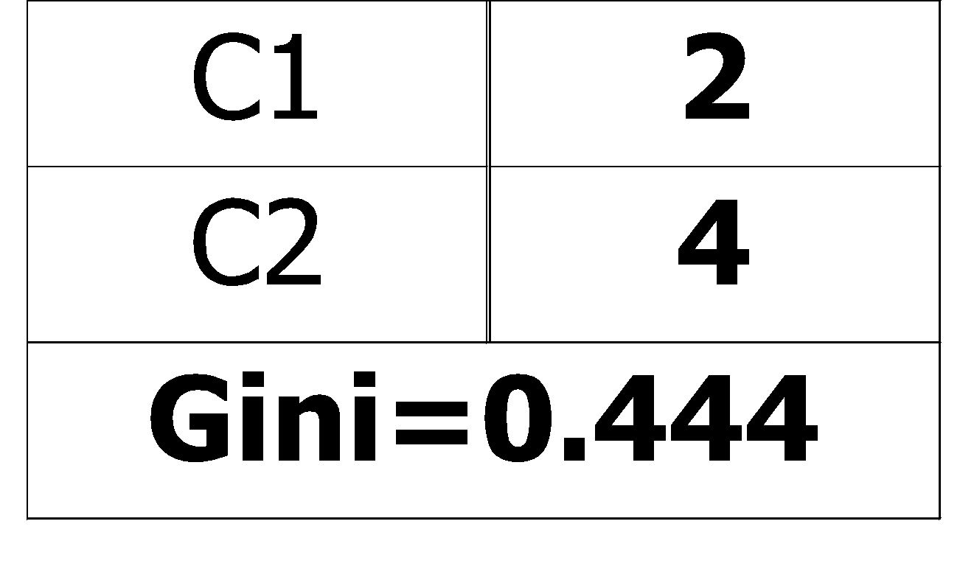
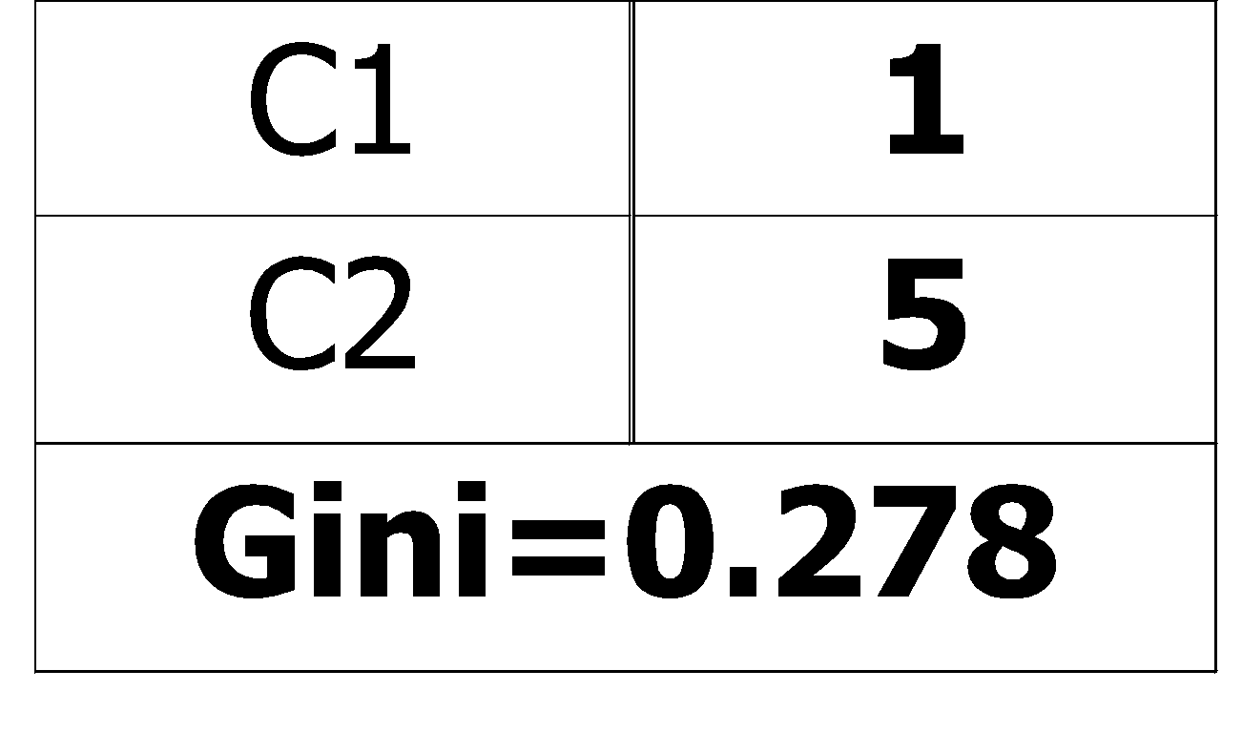
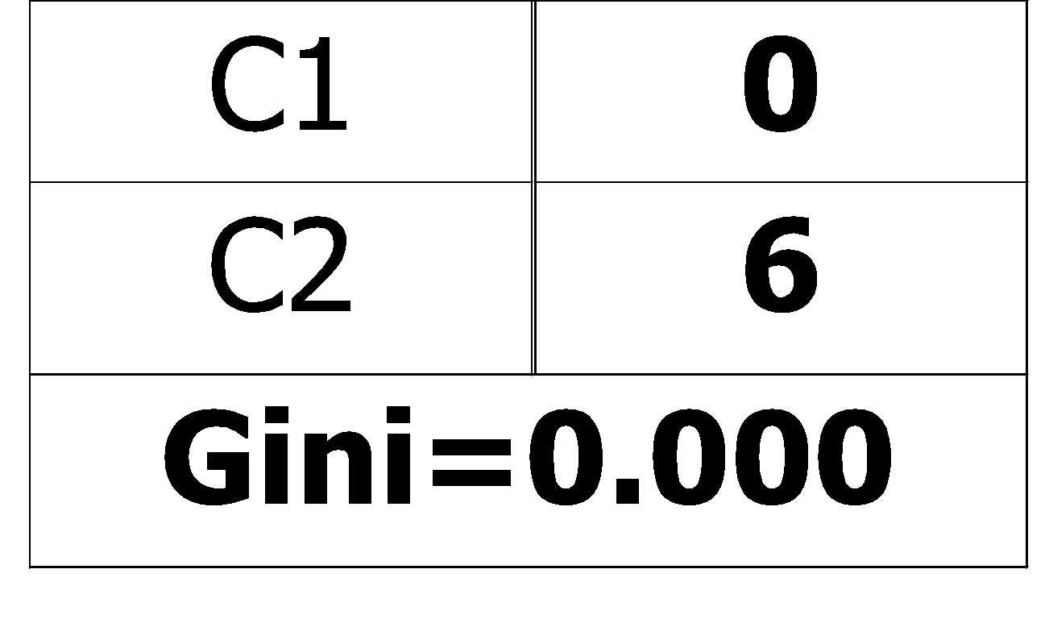
Measure of Impurity: GINI
Gini Index for a given node t :
For 2-class problem (p, 1 – p):
GINI = 1 – p² – (1 – p)² = 2p (1-p)

Slide 34
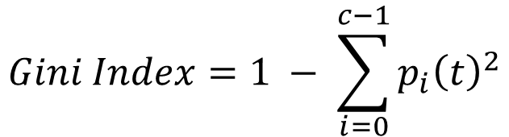
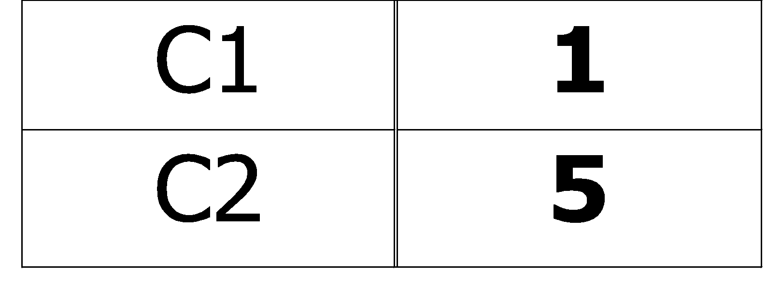
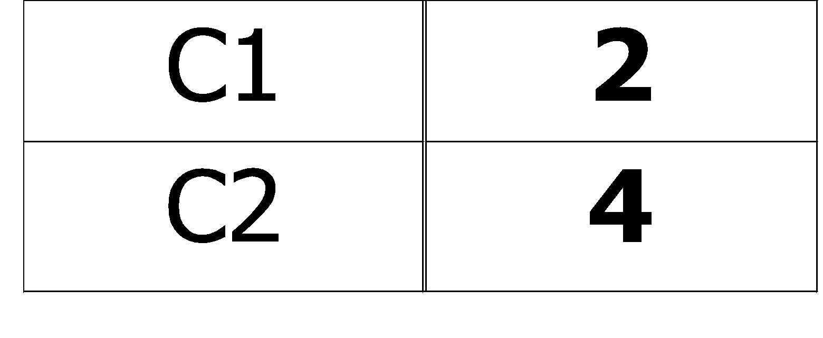
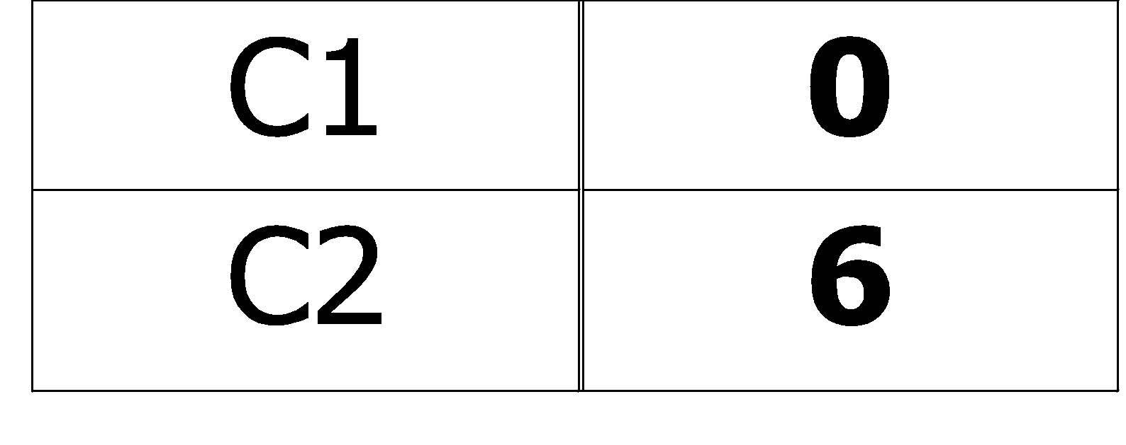
Computing Gini Index of a Single Node
P(C1) = 0/6 = 0 P(C2) = 6/6 = 1
Gini = 1 – P(C1)² – P(C2)² = 1 – 0 – 1 = 0
P(C1) = 1/6 P(C2) = 5/6
Gini = 1 – (1/6)² – (5/6)² = 0.278
P(C1) = 2/6 P(C2) = 4/6
Gini = 1 – (2/6)² – (4/6)² = 0.444

Slide 35
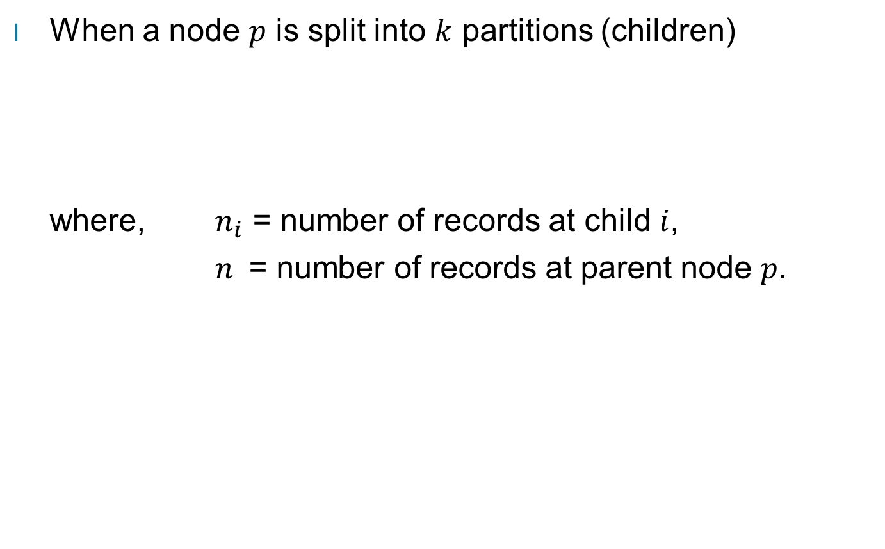
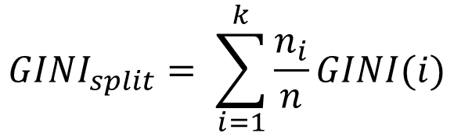
Computing Gini Index for a Collection of Nodes

Slide 36
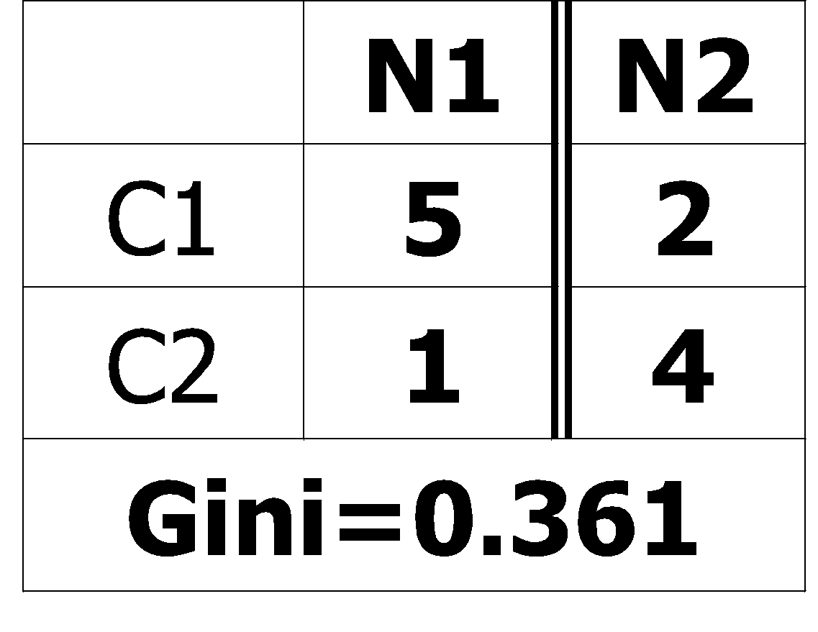
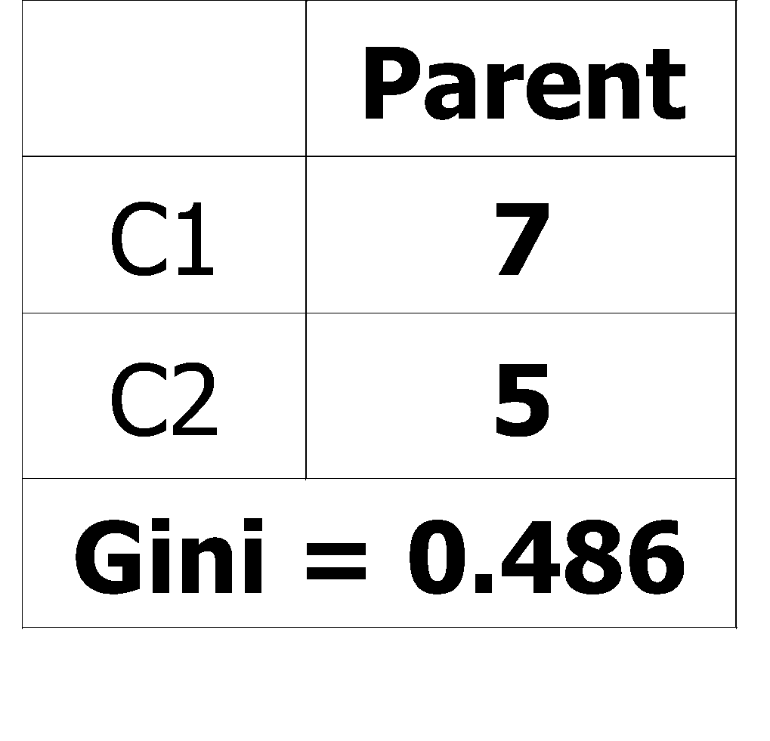
Binary Attributes: Computing GINI Index
Splits into two partitions (child nodes)
Effect of Weighing partitions:
Larger and purer partitions are sought
B?
Yes
No
Node N1
Node N2
Gini(N1) = 1 – (5/6)² – (1/6)² = 0.278
Gini(N2) = 1 – (2/6)² – (4/6)² = 0.444
Weighted Gini of N1 N2 = 6/12 * 0.278 + 6/12 * 0.444 = 0.361
Gain = 0.486 – 0.361 = 0.125

Slide 37
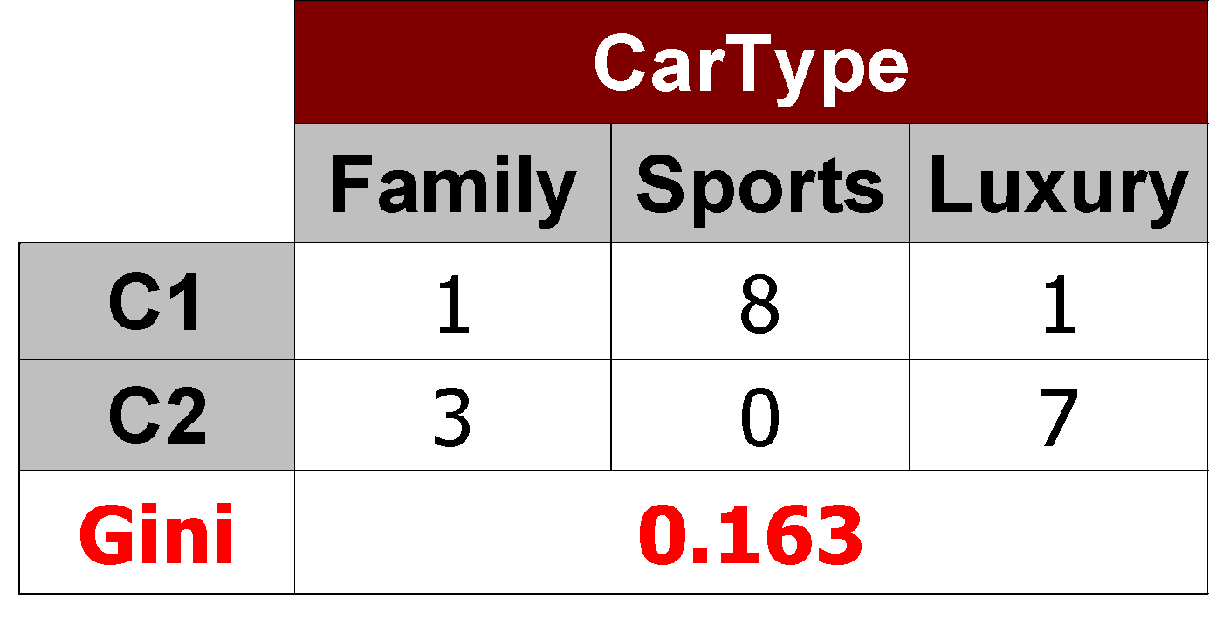
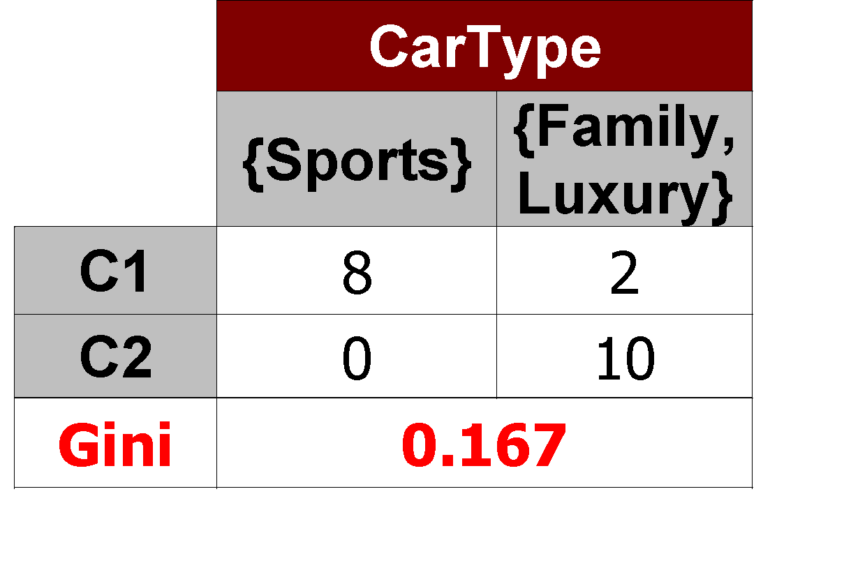
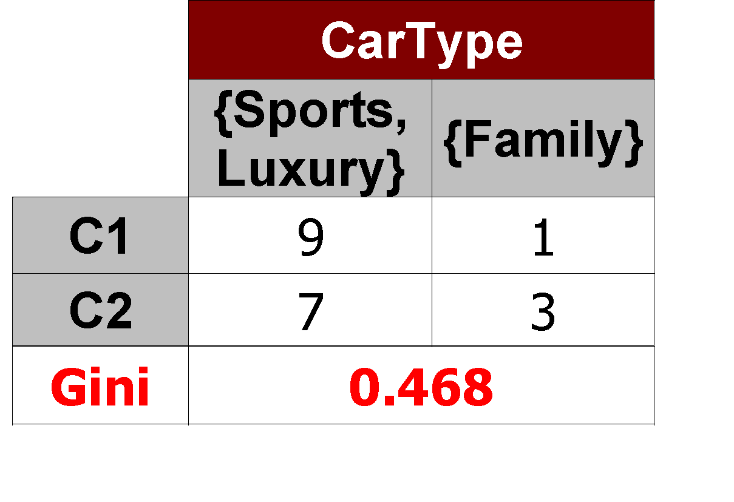
Categorical Attributes: Computing Gini Index
For each distinct value, gather counts for each class in the dataset
Use the count matrix to make decisions
Multi-way split
Two-way split
(find best partition of values)
Which of these is the best?

Slide 38
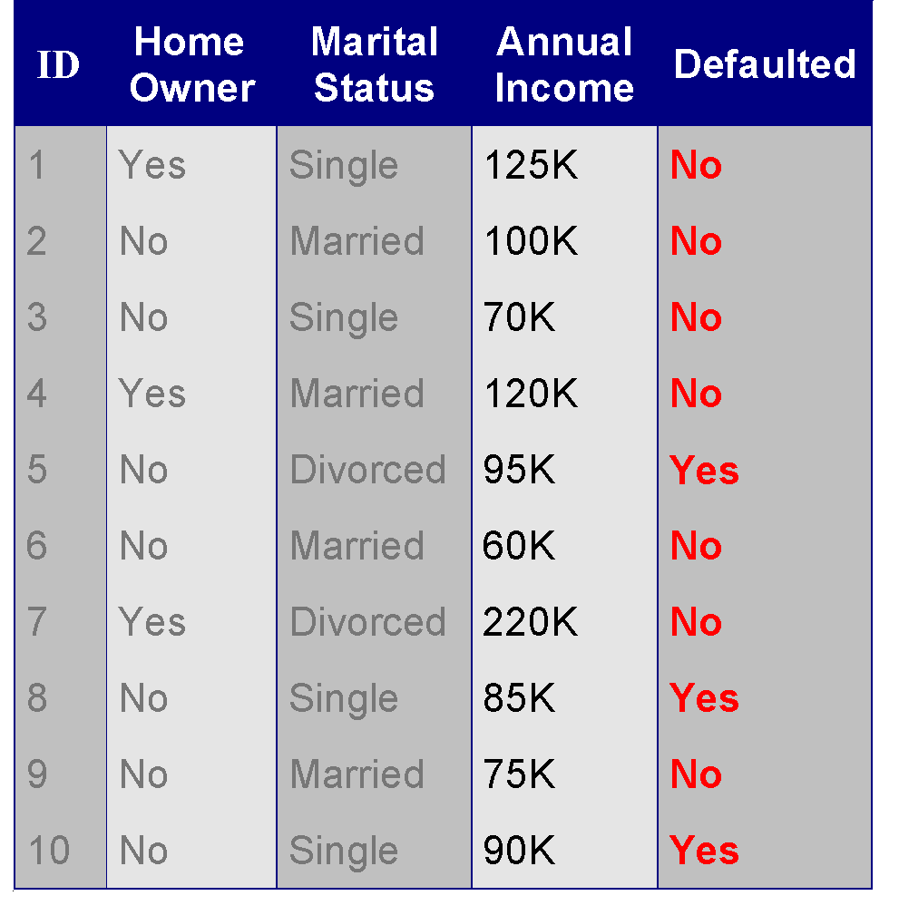
Continuous Attributes: Computing Gini Index
Use Binary Decisions based on one value
Several Choices for the splitting value
Number of possible splitting values = Number of distinct values
Each splitting value has a count matrix associated with it
Class counts in each of the partitions, A ≤ v and A > v
Simple method to choose best v
For each v, scan the database to gather count matrix and compute its Gini index
Computationally Inefficient! Repetition of work.
Annual Income ?
 | ≤ 80 | > 80
Defaulted Yes | 0 | 3
Defaulted No | 3 | 4

Slide 39
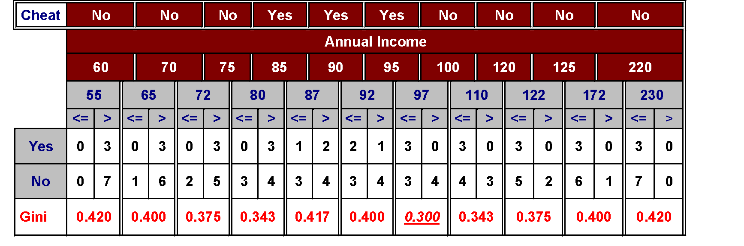
Continuous Attributes: Computing Gini Index...
For efficient computation: for each attribute,
Sort the attribute on values
Linearly scan these values, each time updating the count matrix and computing gini index
Choose the split position that has the least gini index
Sorted Values

Slide 40
Continuous Attributes: Computing Gini Index...
For efficient computation: for each attribute,
Sort the attribute on values
Linearly scan these values, each time updating the count matrix and computing gini index
Choose the split position that has the least gini index
Sorted Values
Split Positions

Slide 41
Continuous Attributes: Computing Gini Index...
For efficient computation: for each attribute,
Sort the attribute on values
Linearly scan these values, each time updating the count matrix and computing gini index
Choose the split position that has the least gini index
Sorted Values
Split Positions

Slide 42
Continuous Attributes: Computing Gini Index...
For efficient computation: for each attribute,
Sort the attribute on values
Linearly scan these values, each time updating the count matrix and computing gini index
Choose the split position that has the least gini index
Sorted Values
Split Positions

Slide 43
Continuous Attributes: Computing Gini Index...
For efficient computation: for each attribute,
Sort the attribute on values
Linearly scan these values, each time updating the count matrix and computing gini index
Choose the split position that has the least gini index
Sorted Values
Split Positions

Slide 44


Measure of Impurity: Entropy

Slide 45

Computing Entropy of a Single Node
P(C1) = 0/6 = 0 P(C2) = 6/6 = 1
Entropy = – 0 log 0 – 1 log 1 = – 0 – 0 = 0
P(C1) = 1/6 P(C2) = 5/6
Entropy = – (1/6) log₂ (1/6) – (5/6) log₂ (1/6) = 0.65
P(C1) = 2/6 P(C2) = 4/6
Entropy = – (2/6) log₂ (2/6) – (4/6) log₂ (4/6) = 0.92

Slide 46


Computing Information Gain After Splitting

Slide 47
Problem with large number of partitions
Node impurity measures tend to prefer splits that result in large number of partitions, each being small but pure
Customer ID has highest information gain because entropy for all the children is zero

Slide 48


Gain Ratio

Slide 49


Gain Ratio
SplitINFO = 1.52
SplitINFO = 0.72
SplitINFO = 0.97

Slide 50


Measure of Impurity: Classification Error

Slide 51

Computing Error of a Single Node
P(C1) = 0/6 = 0 P(C2) = 6/6 = 1
Error = 1 – max (0, 1) = 1 – 1 = 0
P(C1) = 1/6 P(C2) = 5/6
Error = 1 – max (1/6, 5/6) = 1 – 5/6 = 1/6
P(C1) = 2/6 P(C2) = 4/6
Error = 1 – max (2/6, 4/6) = 1 – 4/6 = 1/3

Slide 52

Comparison among Impurity Measures
For a 2-class problem:

Slide 53


Misclassification Error vs Gini Index
A?
Yes
No
Node N1
Node N2
Gini(N1) = 1 – (3/3)² – (0/3)² = 0
Gini(N2) = 1 – (4/7)² – (3/7)² = 0.489
Gini(Children) = 3/10 * 0 + 7/10 * 0.489 = 0.342
Gini improves but error remains the same!!

Slide 54

Misclassification Error vs Gini Index
A?
Yes
No
Node N1
Node N2
Misclassification error for all three cases = 0.3 !

Slide 55
Decision Tree Based Classification
Advantages:
Relatively inexpensive to construct
Extremely fast at classifying unknown records
Easy to interpret for small-sized trees
Robust to noise (especially when methods to avoid overfitting are employed)
Can easily handle redundant attributes
Can easily handle irrelevant attributes (unless the attributes are interacting)
Disadvantages: .
Due to the greedy nature of splitting criterion, interacting attributes (that can distinguish between classes together but not individually) may be passed over in favor of other attributed that are less discriminating.
Each decision boundary involves only a single attribute

